Slide 1

A06 TensorFlow Playground Presentation ​ Martin Demel, Brandie Griffin, Jordan Allen, Sydney Chilson, Marvin Azuogu.​ ​ Department of Science, Technology, Engineering & Math, Houston Community College​ ​ ITAI-1378: Computer Vision – Artificial Intelligence ​ Patricia McManus​ ​ October 3rd, 2024.​

Slide 2
Abstract
This assignment aims to provide a foundational understanding of neural networks and their behavior using TensorFlow Playground, an interactive web-based tool. The team will explore core concepts such as neurons, layers, activation functions, and weights. Through hands-on experimentation with TensorFlow Playground, members will gain valuable insights into how different neural network configurations and parameter adjustments affect network performance.

Slide 3
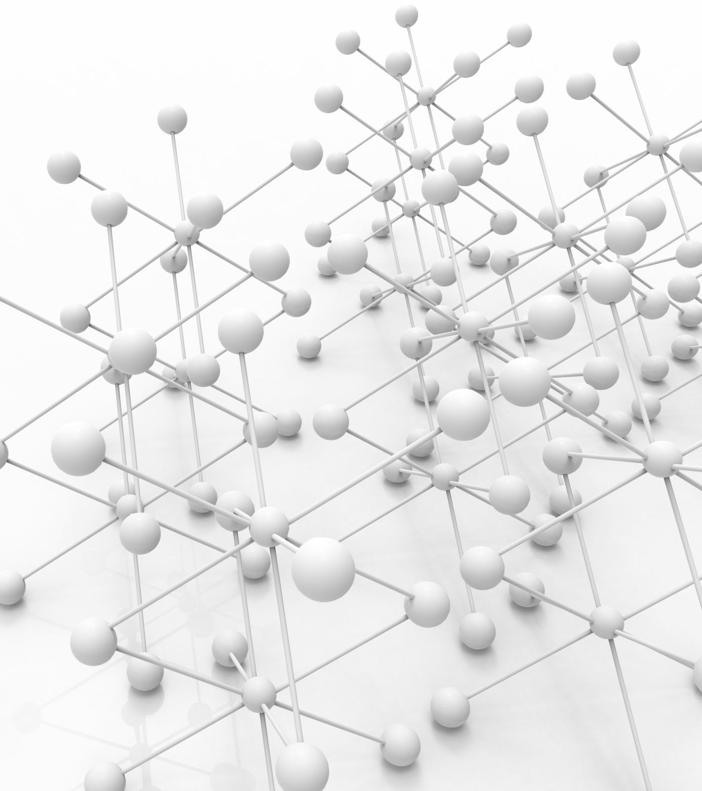
Introduction
Neural networks are a fundamental technology connected to Artificial Intelligence (AI) and Machine Learning. They are loosely model after the human brain. Neural networks are a series of interconnected layers of nodes or neurons that can process and learn from data. Each neuron in the network performs a simple computation, and through multiple layers, these networks can learn complex patterns, make predictions, and classify data with remarkable accuracy. Neural networks have revolutionized fields such as image recognition, natural language processing, and even autonomous systems. The ability to adapt and improve through experience makes them a powerful tool in tackling complex problems across various industries.

Slide 4
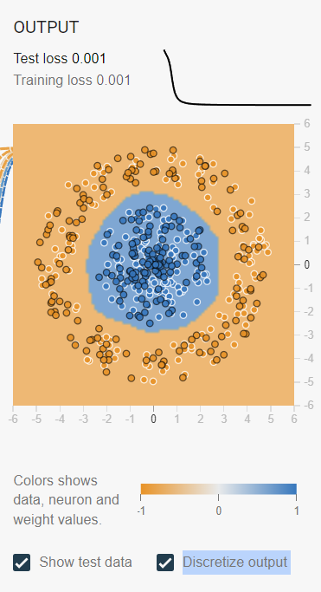
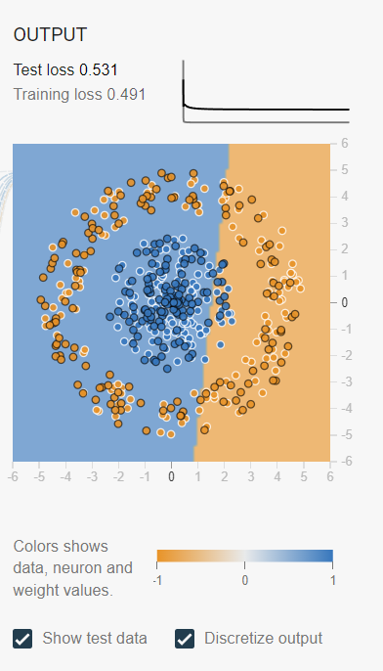
Task 1 – Activation Functions 1/5
What Are Activation Function?
Activation functions are a crucial part of neural networks that allow them to perform non-linear mapping of complex datasets.
In Task 1, we tested ReLU, Tanh, Sigmoid, and Linear activation functions to see how they performed in a neural network.

Slide 5
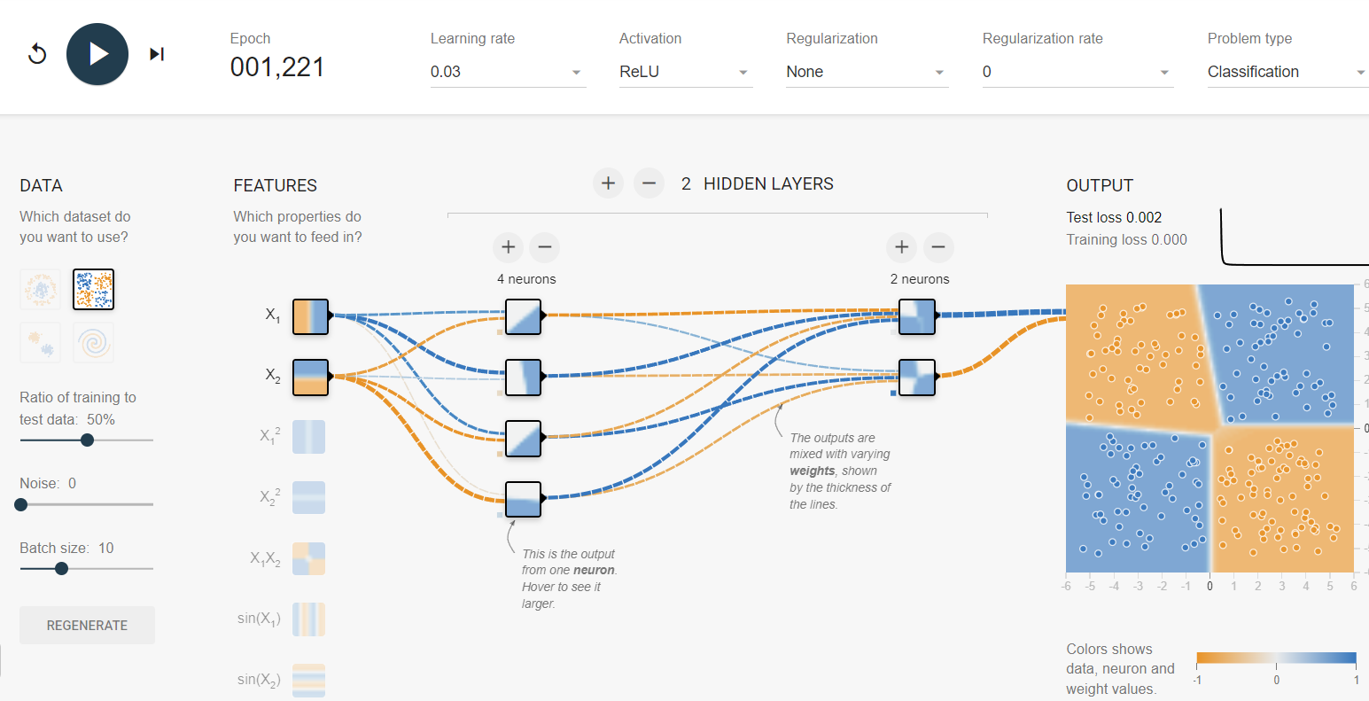
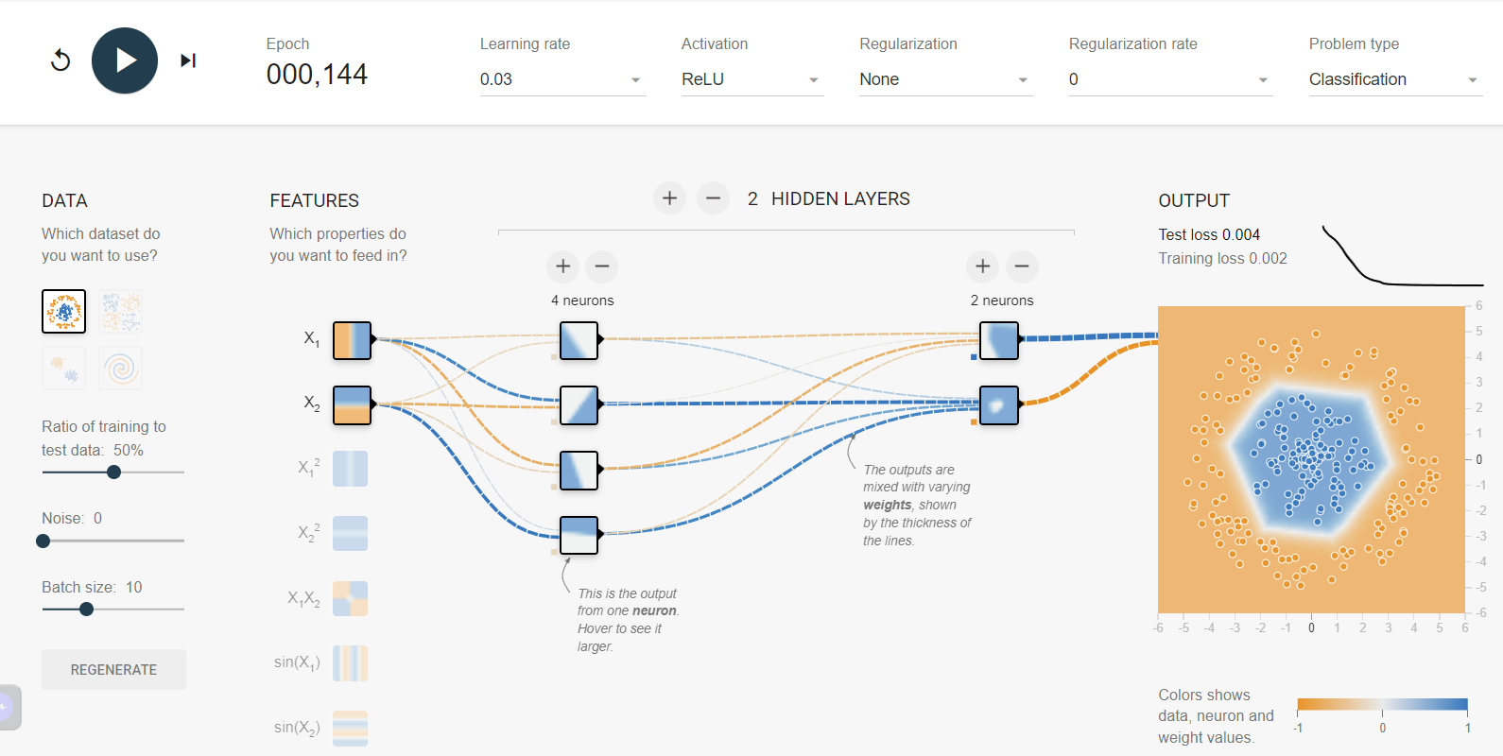
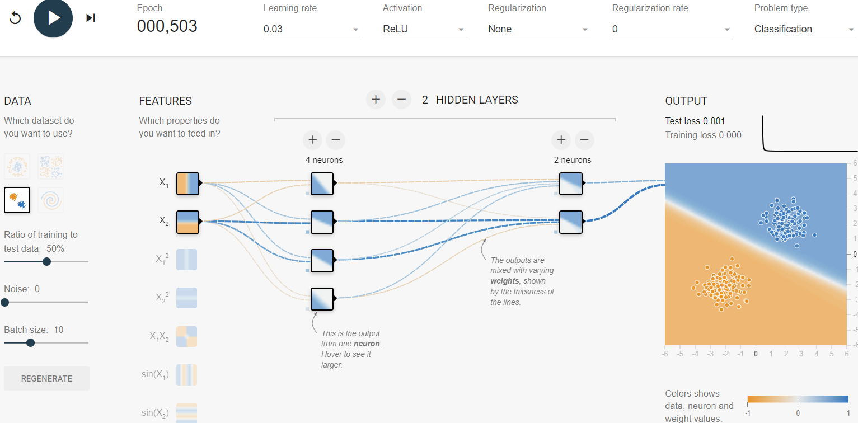
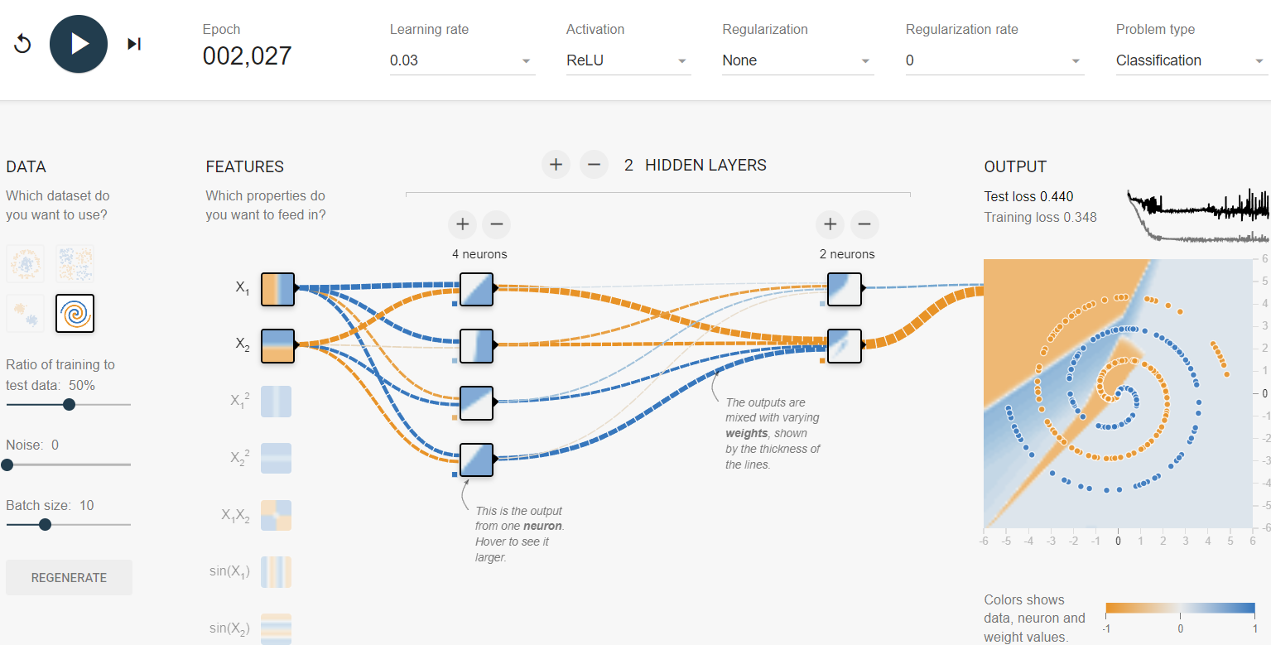
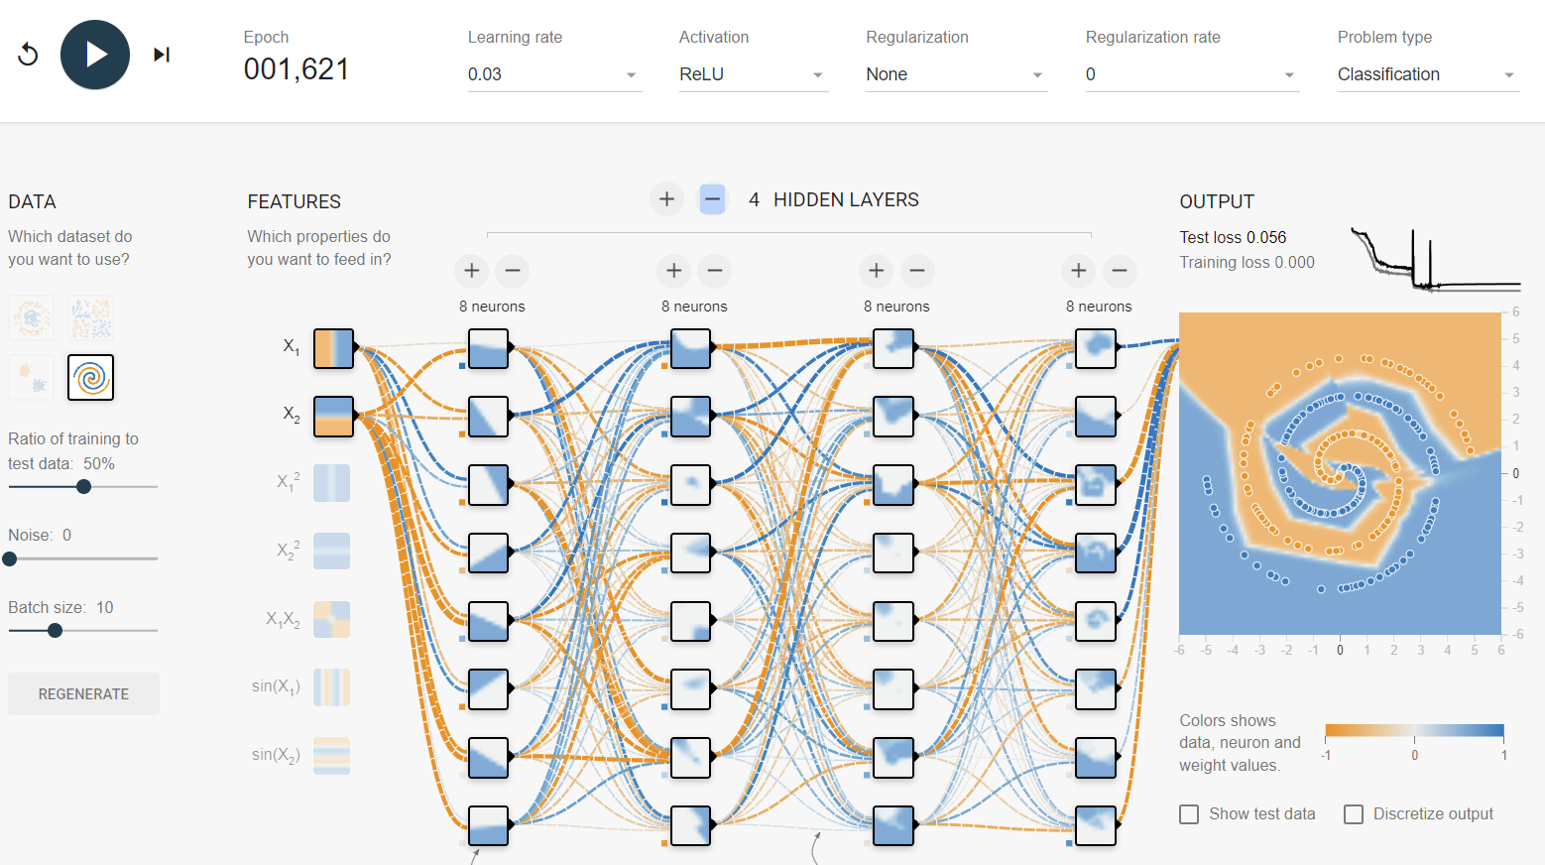
Task 1 – Activation Functions 2/5
To begin, we first start by exploring and testing the ReLU Activation functions using the default network setup. The ReLU Activation functions is known for being simplistic, non-saturating, and sparsity. – Figure 1.
As a result, we noticed while running basic testing that the ReLU activation function was able to easily handle the majority of the available datasets.
However, when it came to the spiral dataset, the ReLU activation function needed significantly more neurons to achieve a possible solution. – Figure 2.
Figure 1 – ReLU activation function.
Figure 2 – Spiral dataset with ReLU activation function.

Slide 6
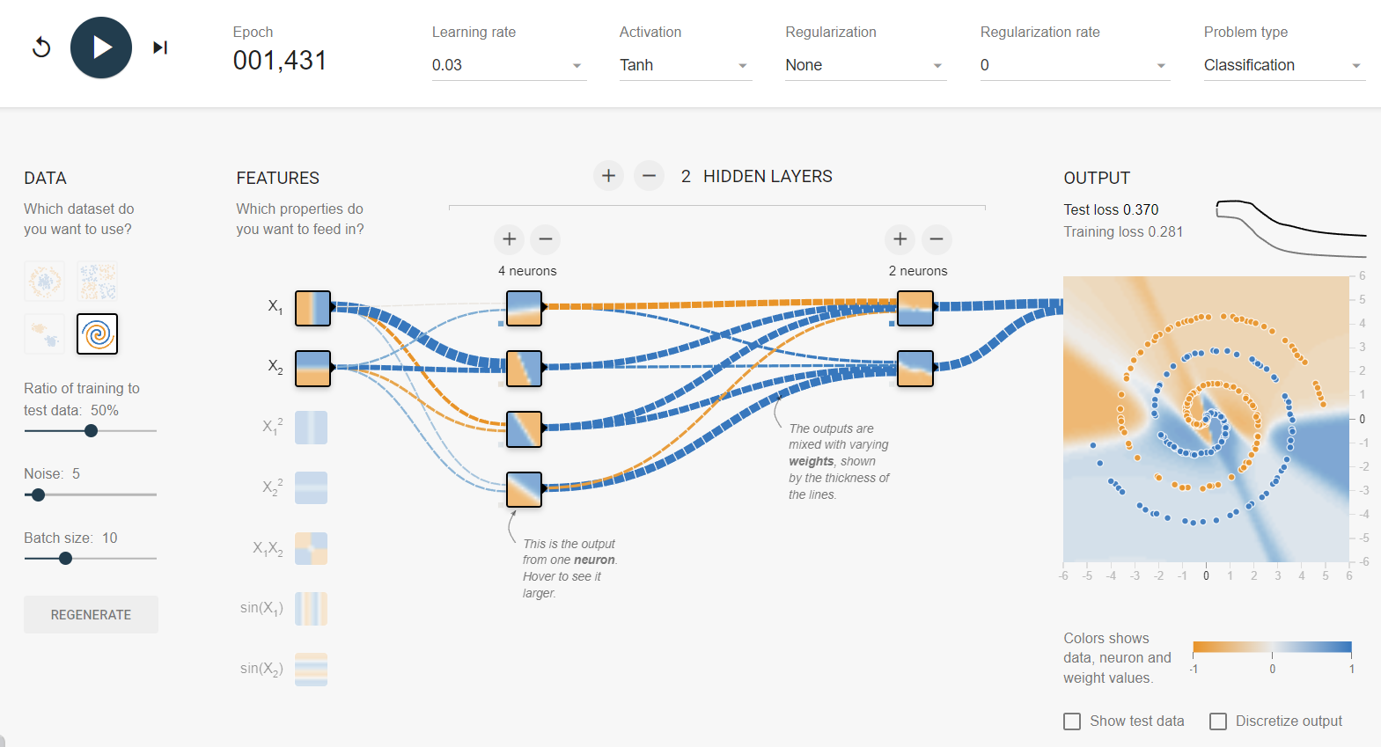
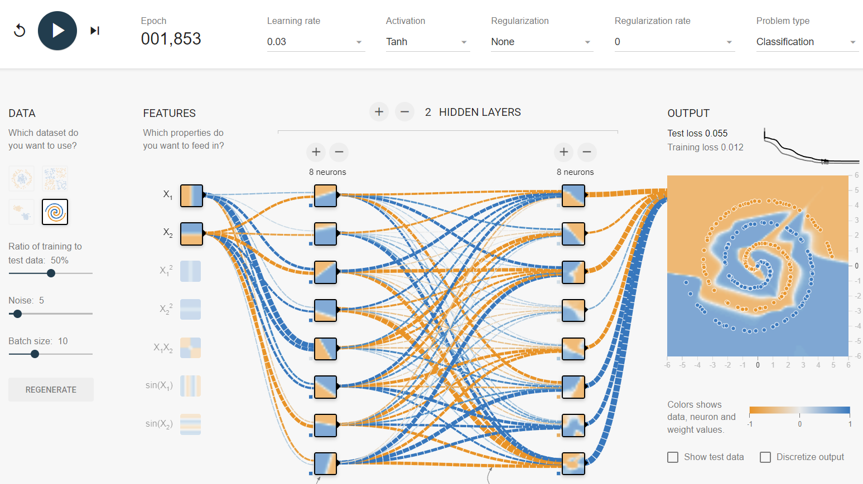
Task 1 – Activation Functions 3/5
Next, we explored and tested the Tanh Activation function using the default network setup.
The Tanh Activation function is known for being helpful when using data that is Zero-centered and being able to deal with both positive and negative data.
When we tested the Tanh Activation function, we noticed that it easily found solutions to all the datasets except the spiral dataset. - Figure 1.
However, compared to ReLU, the Tanh activation function required way less neurons and hidden layers to come up with a possible solution.
Figure 1 – Spiral dataset

Slide 7
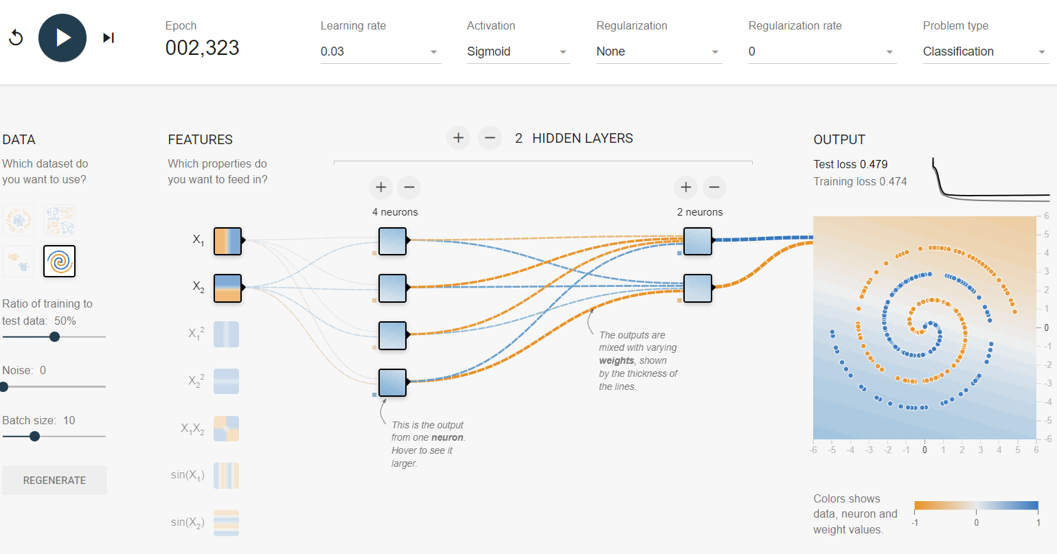
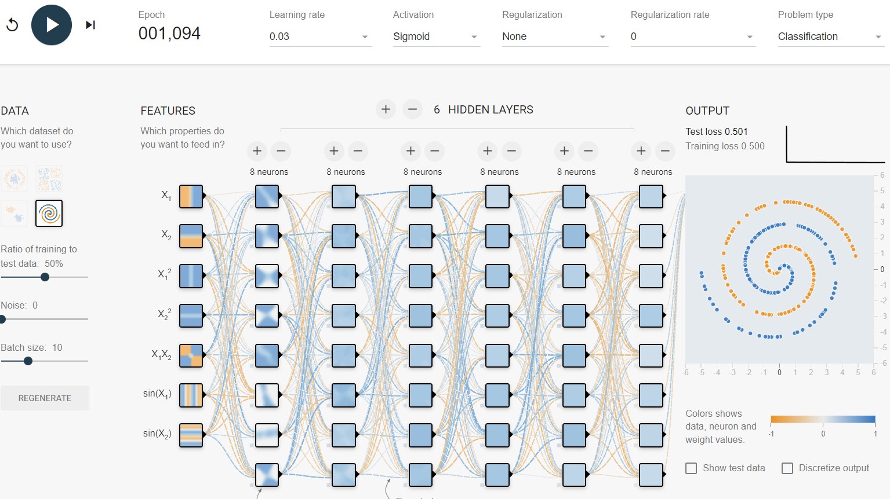
Task 1 – Activation Functions 4/5
Here we explored and tested the Sigmoid activation function using the default network setup. The Sigmoid activation function strength is its ability to distinguish between binary classifications.
When testing the Sigmoid activation function, we noticed that it was able to find a solution to all the datasets except the spiral dataset. – Figure 1. Furthermore, no matter how much we increased the number of neurons, hidden layers, and features the Sigmoid activation function was not able to find a solution to that dataset. – Figure 2.
Figure 1 – Spiral dataset examination
Figure 2 – Spiral dataset examination with increased number of neurons

Slide 8
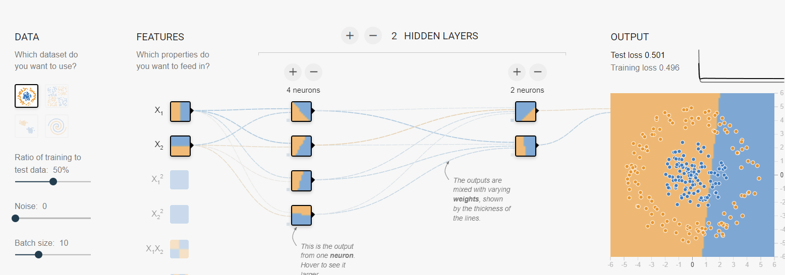
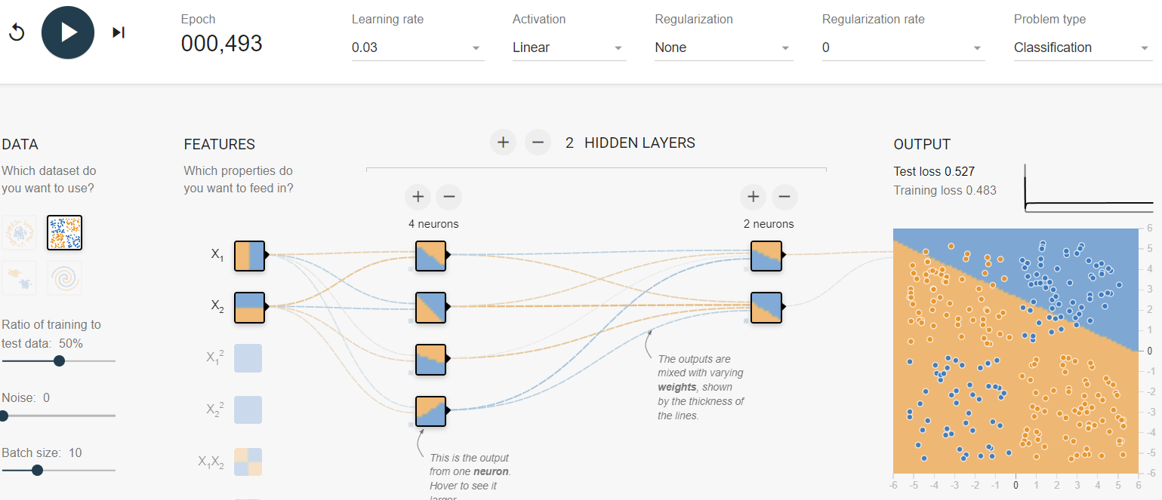
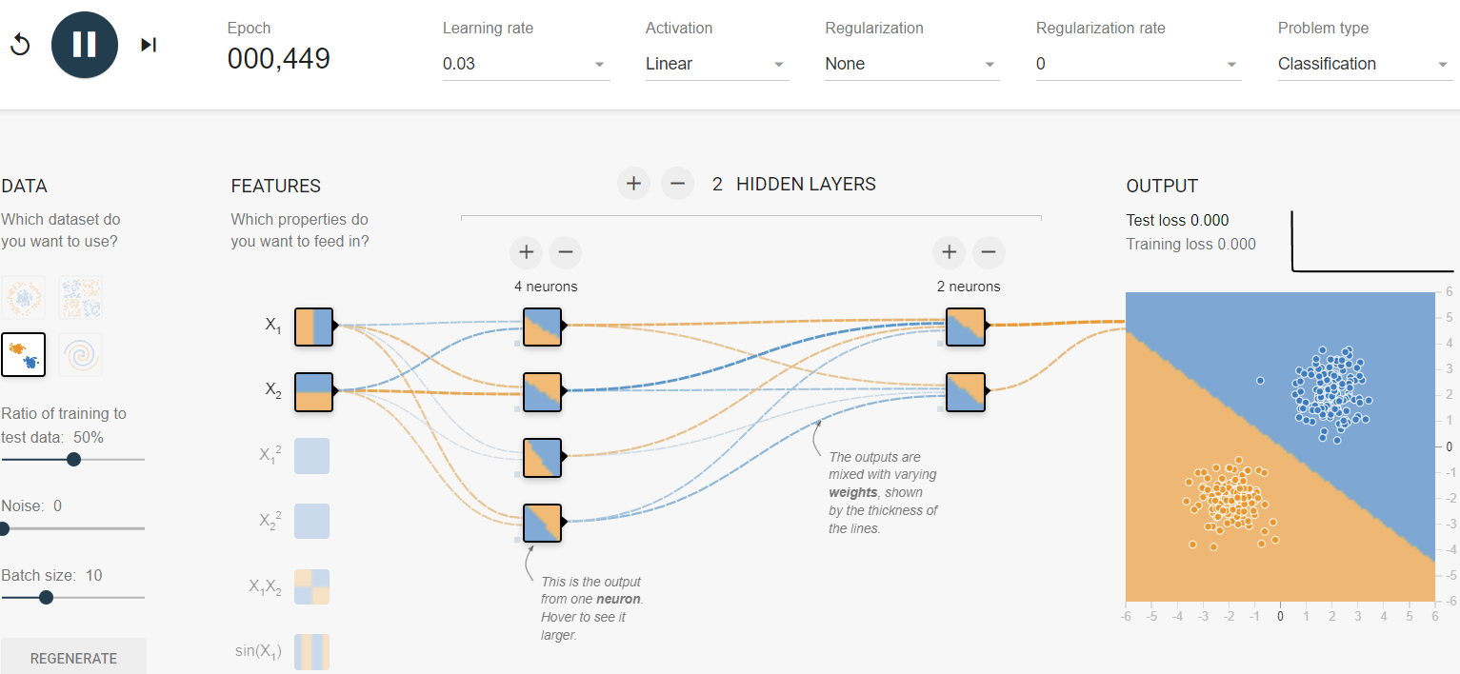
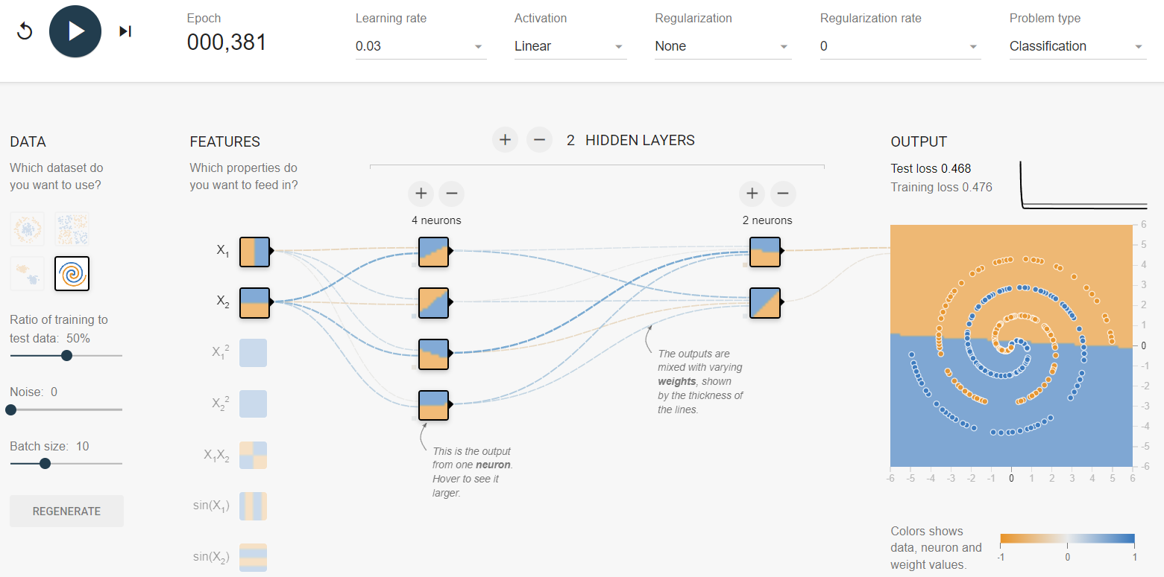
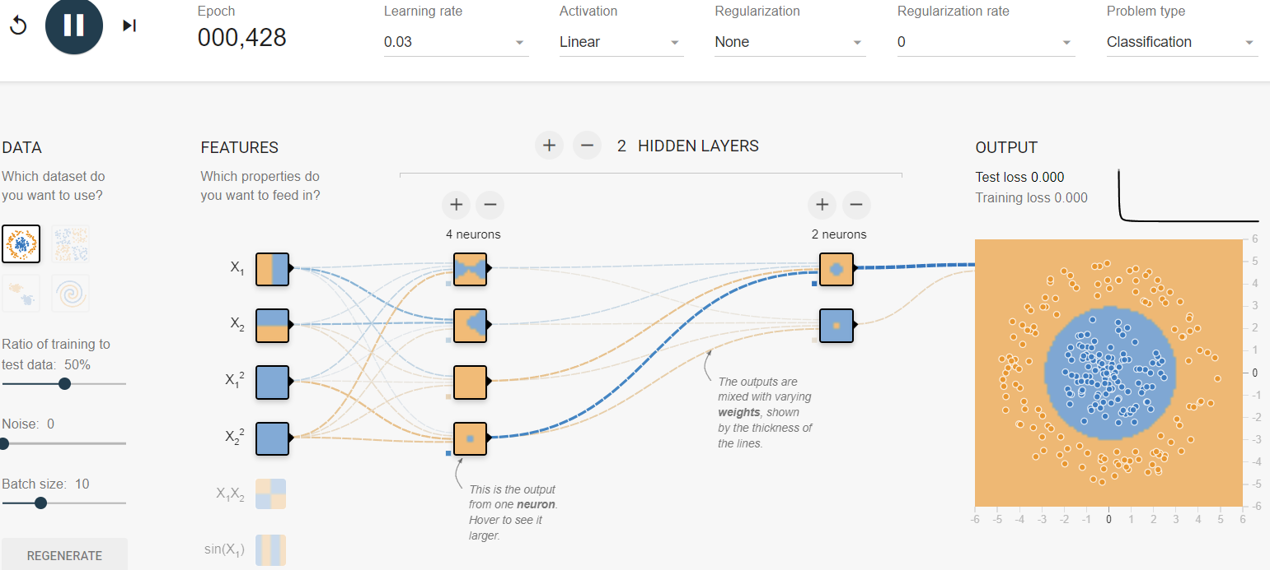
Task 1 – Activation Functions 5/5
Lastly, we explored and tested the linear activation function using the default network setup.
The Linear activation function is the simplest activation function. No matter the dataset the Linear activation function will always give a linear solution to the output. – Figure 1.
While testing, the only way we were able to get a solution that appeared non-linear and worked for non-linear datasets was by increasing the number of features. – Figure 2.
Figure 1 – Linear Activation Function examples
Figure 2 – Non- linear dataset

Slide 9
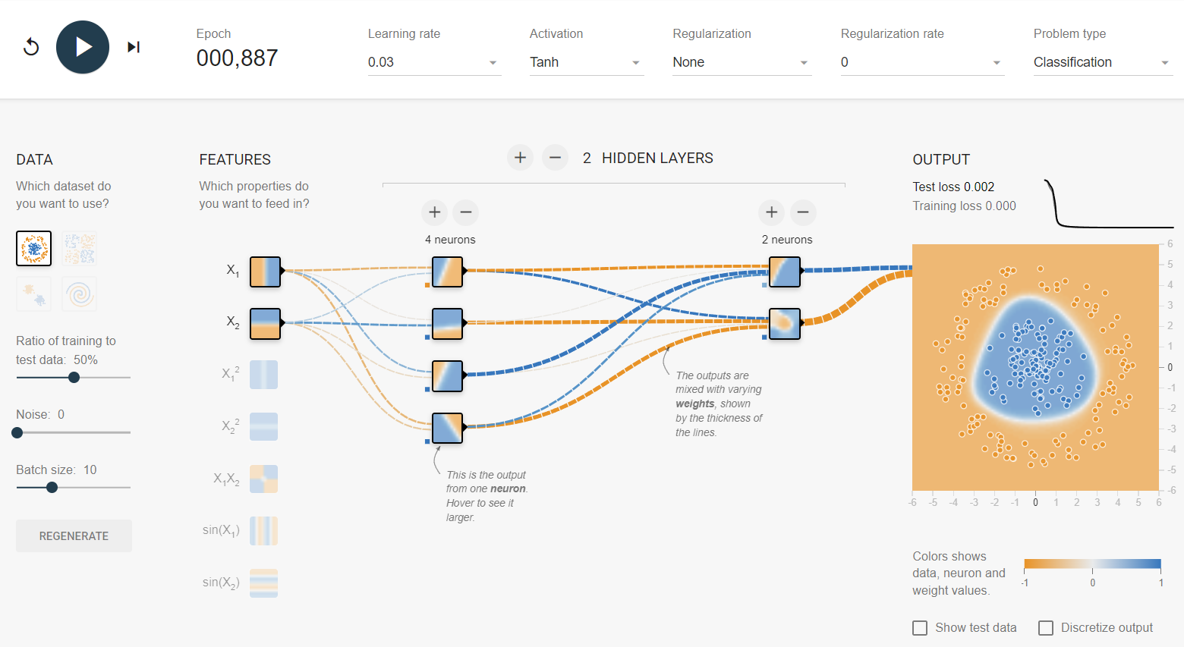
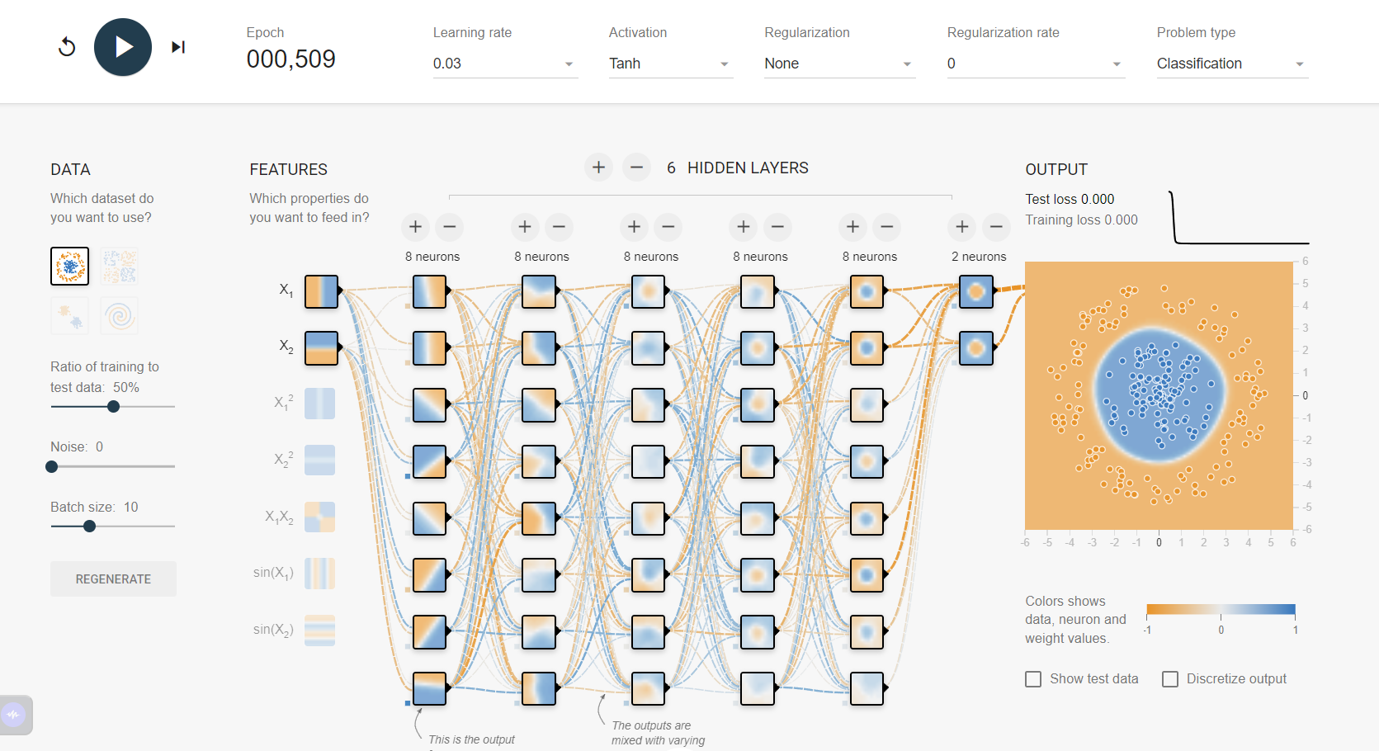
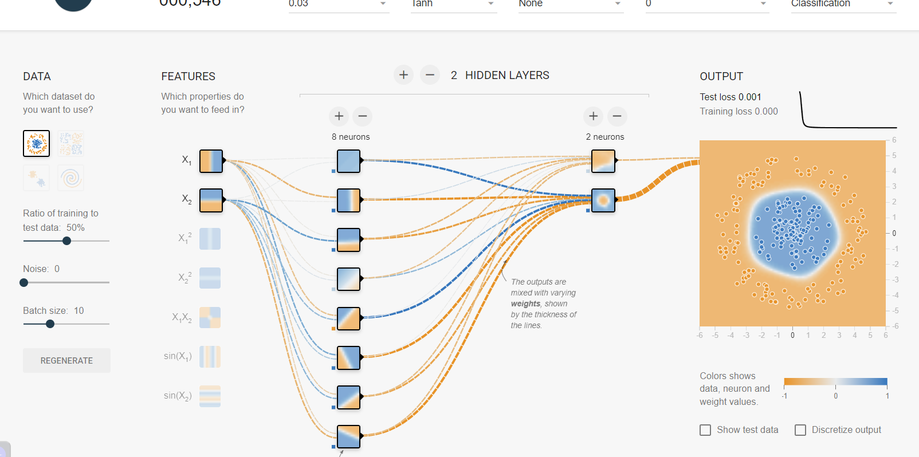
Task 2 – Hidden Layers Neurons 1/2
In Task 2, we tested how changing the number of neurons and hidden layers impacted the output. As a baseline, we use the default neural network that is displayed upon opening Tensorflow playground. – Figure 1.
Figure 1 – Example of the neuron and hidden layers change

Slide 10
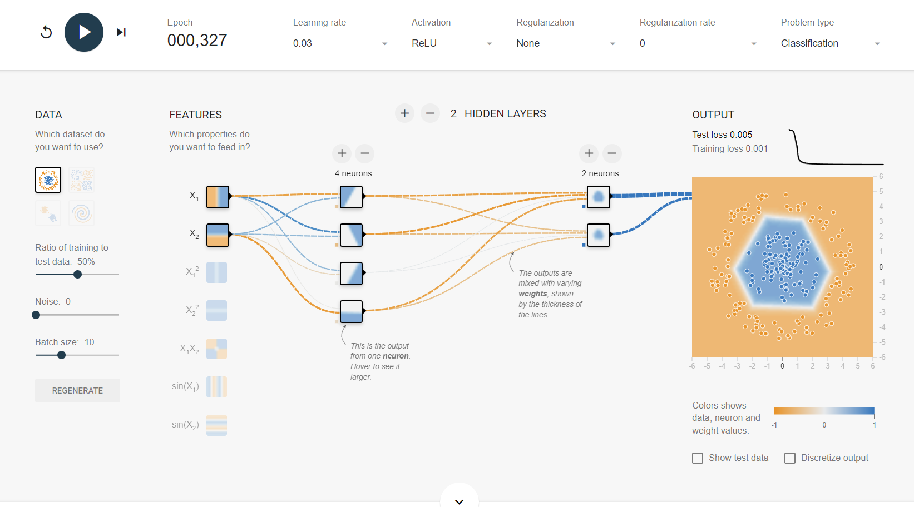
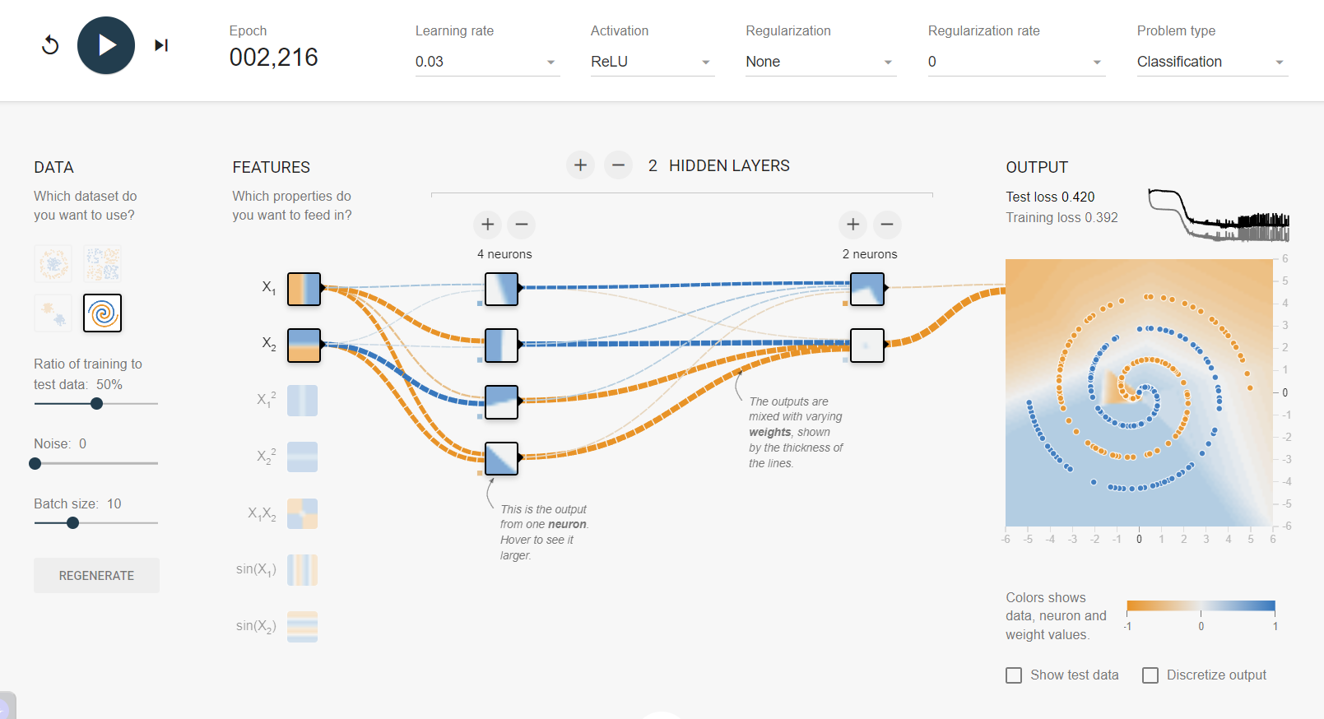
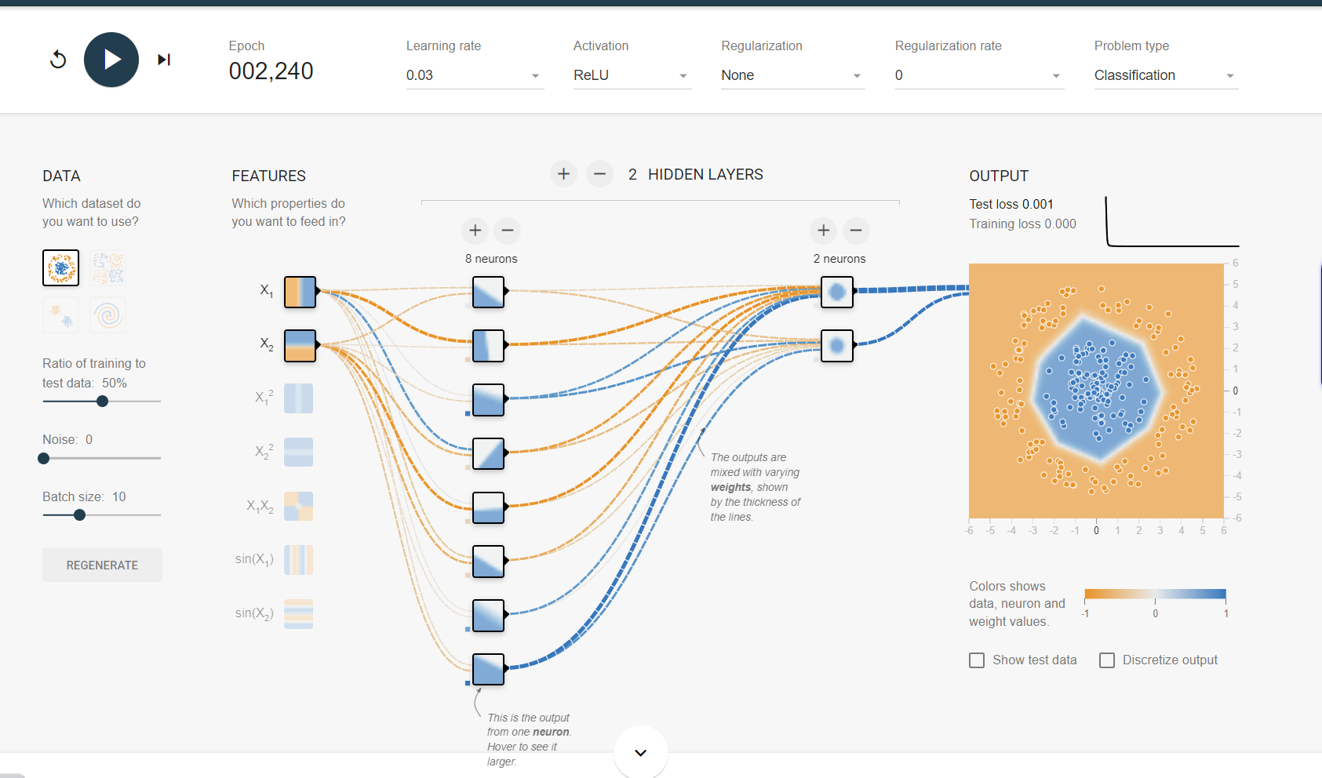
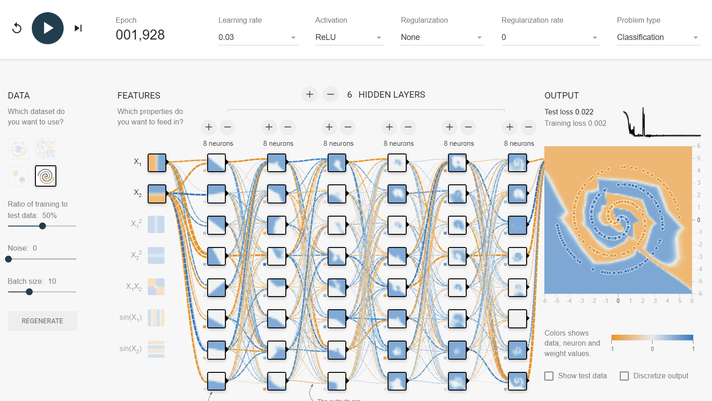
Task 2 – Hidden Layers Neurons 2/2
To start, we first compared how adding more neurons to a single hidden layer affected the output. – Figure 1. In addition, by comparing the increased neuron count to the baseline, we notice that the complexity of the output increased. Furthermore, this was made even more apparent when using the ReLU activation Function.
However, despite the increased complexity of the network, we noticed that the network struggled when using a difficult dataset like the spiral dataset. Figure 2.
One way to create a neural network that can handle difficult datasets is by increasing the number of hidden layers and neurons. – Figure 3.
Now, not only does it have increased complexity, but it can also combine levels of its complexity together from hidden layer to hidden layer. As a result, by increasing the number of neurons and hidden layers, we ended up with a neural network capable of solving difficult datasets.
Figure 1 – Neurons added to a single hidden layer
Figure 2 – Spiral dataset
Figure 3 – Spiral dataset with increased number of hidden layers and neurons

Slide 11
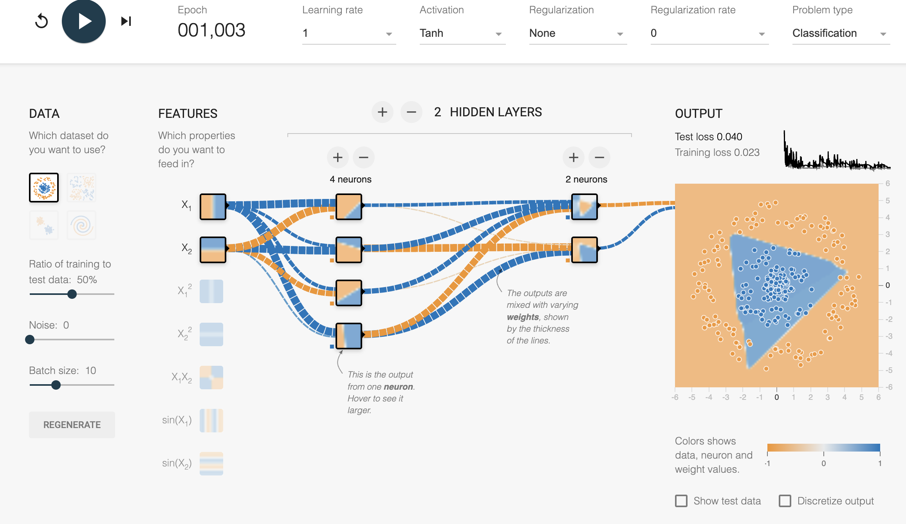
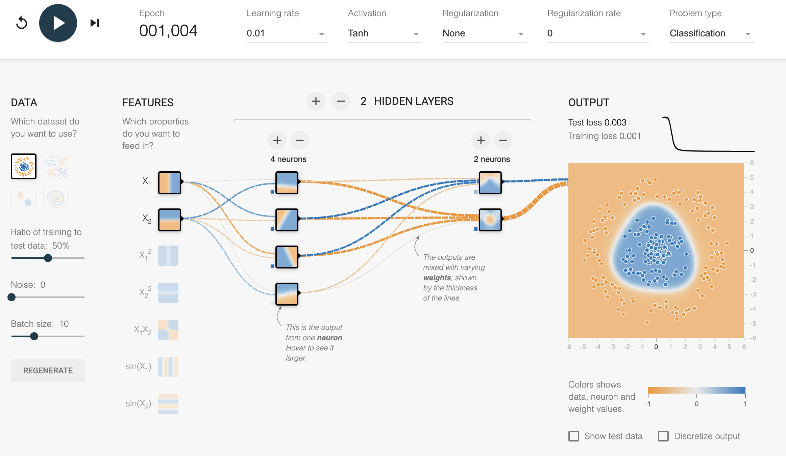
Task 3 – Learning Rate and its impact on Neural network Performance
Learning Rate directly impacts the performance of the neural networks.
We have performed an analysis with two different learning rates ( 1.0 and 0.01) and we have identified the following:
With a learning rate set at 1.0, the model reached a solution quickly, however, the high learning rate compromised the overall performance. This instability is reflected in the decision boundary and can be seen in Figure 1.
When we decreased the learning rate to 0.01, we have observed an increase in the processing time. As a result, the model's performance significantly improved. This improvement is due to the smaller learning rate allowing the model to make more incremental adjustments to the weights during the training. This ultimately leads to improved optimization.
Furthermore, to support the results, with a learning rate at 1.0 the training and test losses were significantly higher, captured at 0.023 and 0.040 respectively. With the learning rate set at 0.01, we can see significant improvement and the training loss dropped to 0.001 and the test loss dropped to 0.003.
The significant improvement demonstrates an improvement in both, accuracy and generalization.
Figure 1 – Learning rate set at 1.0
Figure 2 – Learning rate set at 0.01

Slide 12
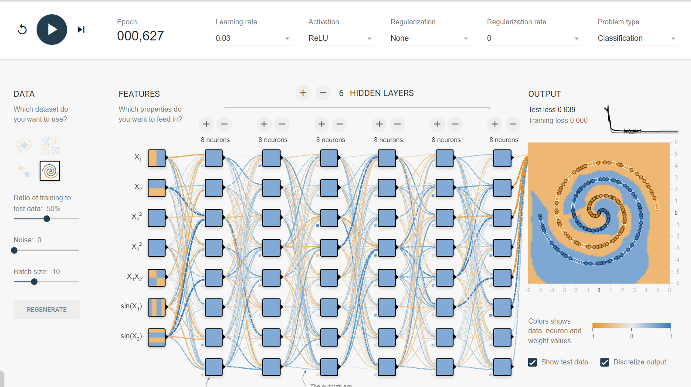
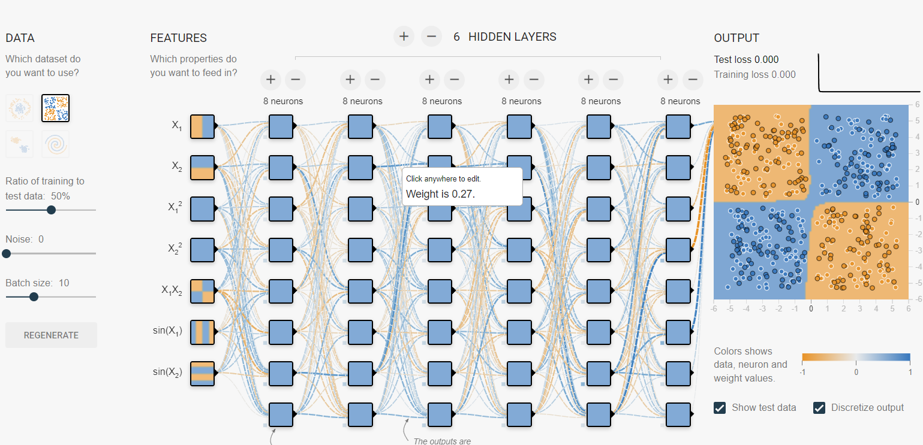
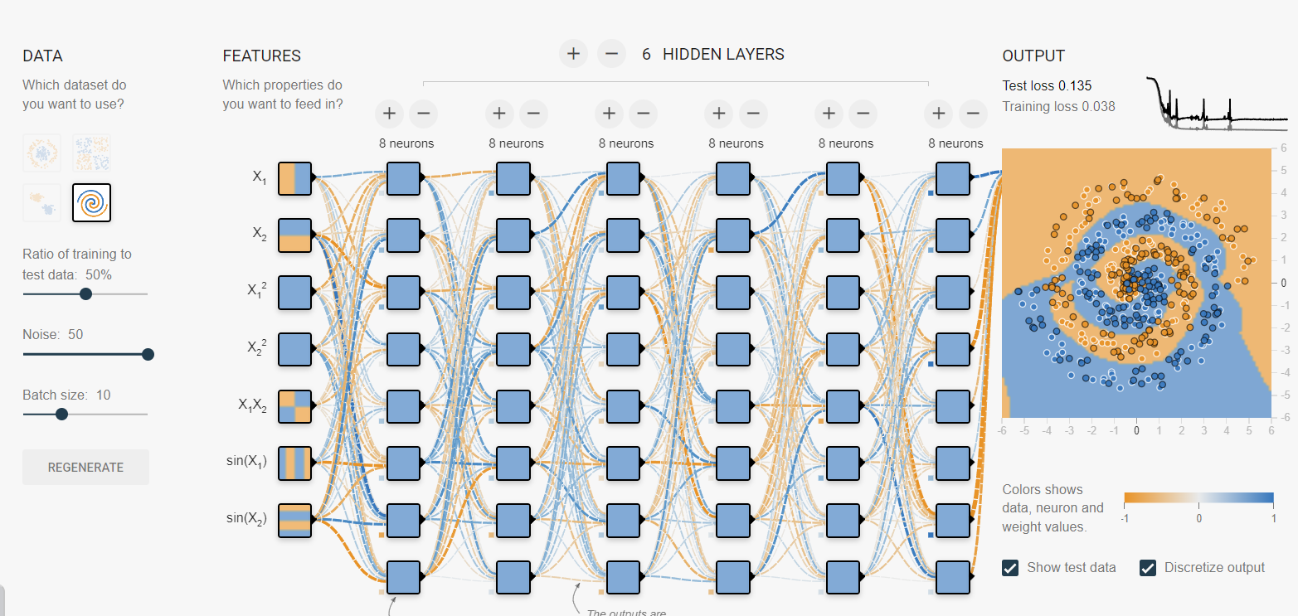
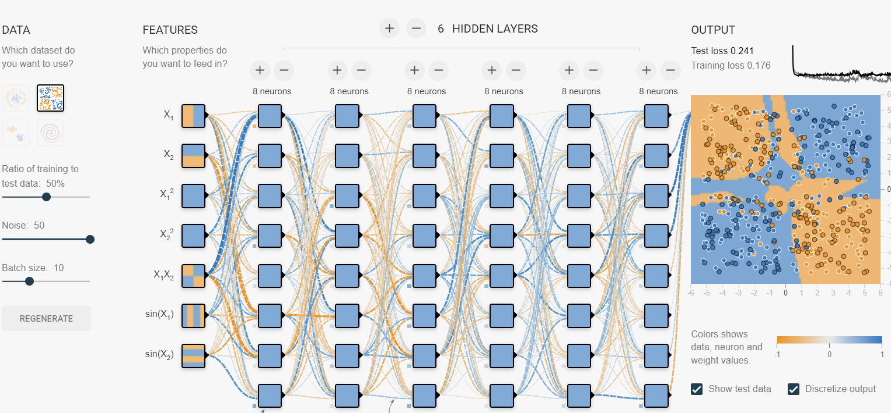
Task 4 – Data Noise
In task 4, we tested how changing the amount of Noise in different datasets affects a neural network.
What is Data Noise?
Data noise is excess data that tends to clutter up datasets, making it harder for a neural network to learn from them.
While testing, we use a neural network with the ReLU function, utilizing all available features, hidden layers, and neurons. When changing the amount of noise in the existing datasets, we noticed that when the noise increased, the output became more chaotic.
Figure 1 – Neural network with ReLU function.
Figure 2 – Neural network with ReLU function with increased noise

Slide 13
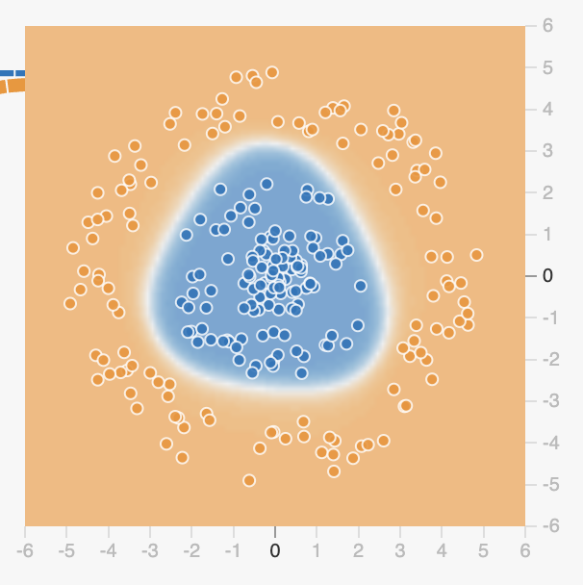
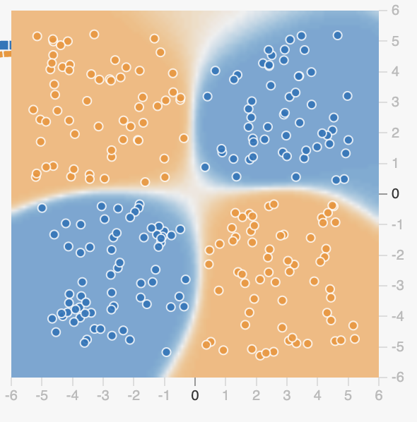
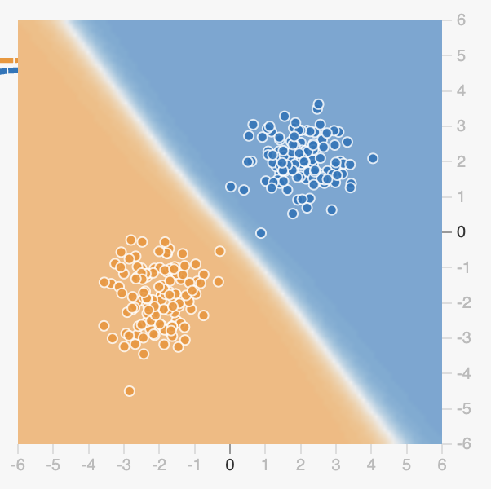
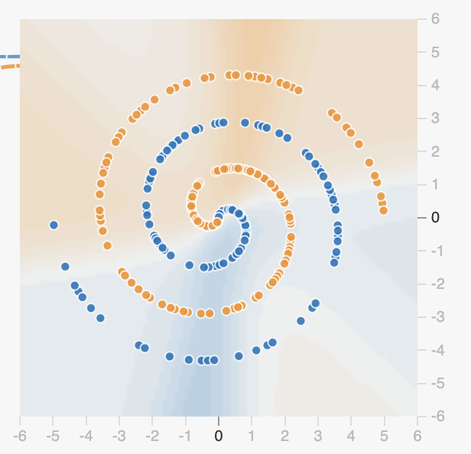
Task 5 – Dataset Exploration
We have experimented with the different types of the datasets using the same neural network configurations. 2 hidden layers, 4 neurons in the first layer and 2 in second, learning rate at 0.01,the Tanh activation and 1k epochs for this exercise demonstration.
Circle dataset – Low learning rate supported the perfectly defined boundary between the two classes even with simple architecture. - Figure 1.
Exclusive or dataset – The network experienced more complex data distribution, and it has clearly defined nonlinear separation successfully. – Figure 2. More layers or neurons would improve the results further.
Gaussian dataset – Network handled this dataset with excellence. Simple and clean decision boundary as it can be seen in Figure 3.
Spiral dataset – Was the most challenging for the defined settings. The network struggled to learn complex curved boundary. – Figure 4.
Dataset complexity has direct impact on the neural network performance. Simple datasets like circle and gaussian can be handled with a basic architecture, whereas the complex dataset like XOR or spiral require deeper networks and longer training periods.
Figure 1 – Circle dataset
Figure 1 – Exclusive dataset
Figure 1 – Gaussian dataset
Figure 1 – Spiral dataset

Slide 14
Conclusion / Individual Reflection
Our findings from using TensorFlow have shed light on the broader significance of neural networks. We have learned that by experimenting with various parameters such as activation function, learning rates, data noise and hidden layers we can significantly differentiate the desired outcome. The findings offer key insights for neural network practitioners, researchers, and educators, guiding model selection and training strategies. They highlight the importance of understanding how networks adapt to various conditions, aiding in the advancement of this machine learning technique.
The hands-on experience confirmed the importance to understand the neural networks. Designing effective neural network involves careful definition of the parameters, especially in real life scenarios such as medical image analysis. The right balance between speed, accuracy and generalization is important. – Martin Demel
Using TensorFlow taught us how neural networks function and how different setting, like the number of neurons and learning rates, can change their results. Doing so showed us how to adjust the networks to achieve enhanced performance.. - Brandie Griffin
Personally, using TensorFlow helped me visualize the workflow of neural networks. By experimenting with the activation functions, hidden layer, learning rate, data Noise, and the different datasets, I was able to really visualize how modern AI models are capable of taking data and transforming it into useful information. - Jordan Allen
Through this hands-on exploration, we have gained a deeper understanding of how neural networks process different types of data. TensorFlow Playground offers a simplified yet powerful environment to observe the effects of various parameters like activation functions, learning rates, and neuron counts. Some challenges faced included overfitting in certain datasets when using deep networks, which was mitigated by reducing the number of neurons and adding regularization. These insights are vital for developing efficient and robust neural networks, applicable to a wide range of machine learning tasks. - Marvin Azuogu

Slide 15
References
GeeksforGeeks. (2024d, July 25). Why is ReLU used as an activation function? GeeksforGeeks. https://www.geeksforgeeks.org/why-is-relu-used-as-an-activation-function/
Ali, M. (2024, September 12). Introduction to activation functions in neural networks. https://www.datacamp.com/tutorial/introduction-to-activation-functions-in-neural-networks
Nik. (2023, October 15). TANH Activation Function for Deep Learning: A complete guide. Datagy. https://datagy.io/tanh-activation-function/
GeeksforGeeks. (2024d, July 16). Activation functions in Neural Networks. GeeksforGeeks. https://www.geeksforgeeks.org/activation-functions-neural-networks/#sigmoid-function
Wright, G. (2024, April 12). noisy data. Business Analytics. https://www.techtarget.com/searchbusinessanalytics/definition/noisy-data
Carter, D. S. a. S. (2024). Tensorflow — Neural Network playground. https://playground.tensorflow.org/

